Slide 1
Mars Rover Meeting
30 January 2025

Slide 2
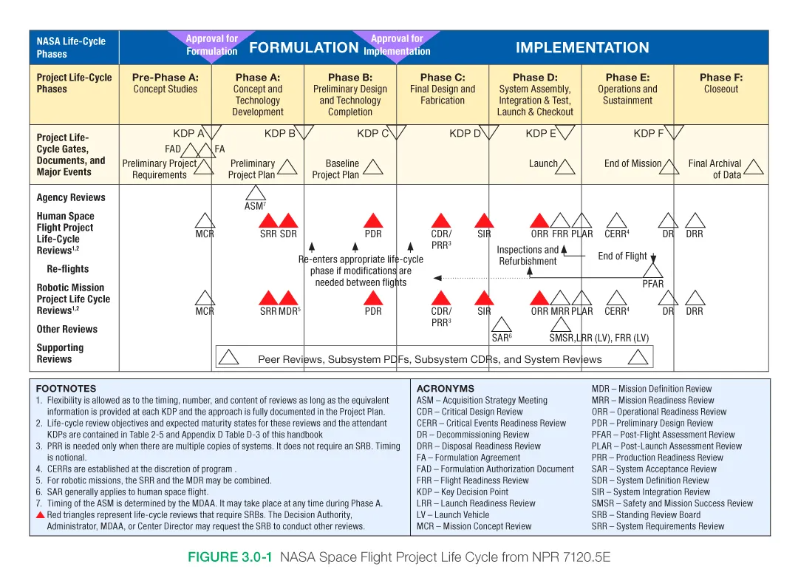
Where are we?

Slide 3
What is our mission?

Slide 4
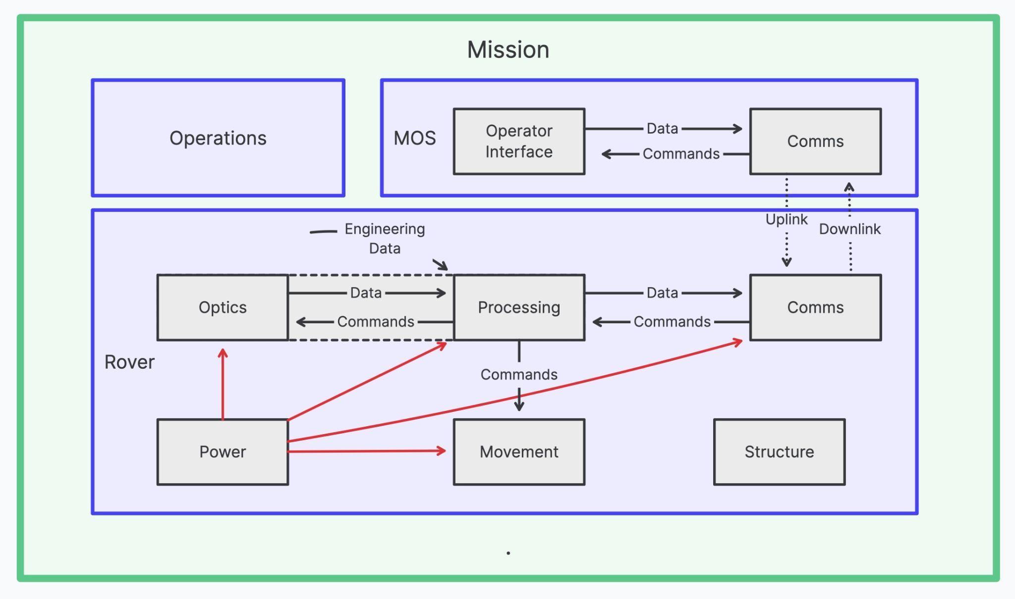
How we will accomplish our mission

Slide 5
Leadership
Rover team lead
Mechatronics lead
Structure lead
Processing lead
MOS/Ground station lead
Command lead
Control lead

Slide 6
How will we make sure to accomplish our mission?

